Slide 1

CRITEO ATTRIBUTION
MODELING
Group Number – 5
250843025004 - Aditya Vinayak Desai
250843025007 - Anjali Jha
250843025031 - Manoranjan Ghadei
250843025039 - Prajakta Dipak Patil
Guided By :
Milind Kapse Sir

Slide 2
CRITEO ATTRIBUTION
MODELING
End-to-End ML Pipeline for Digital Ad Attribution Prediction

Slide 3
Project Overview
16.4M
700+
6.1M
2.69%
Total Impressions
Campaigns
Users
Attribution Rate
Business Objective
Dataset Specifications
Predict ad impressions that will receive attribution credit
Dataset Name: Criteo Attribution Modeling Dataset
Link: kaggle.com/datasets/sharatsachin/criteo-attribution-modeling

Slide 4
METHODOLOGY

Slide 5
Pipeline Flow
1
2
3
4
5
Data
Loading
Exploratory
Data Analysis
Feature
Engineering
Model
Training
Model
Selection
CSV → PostgreSQL
COPY command
Distribution &
imbalance analysis
35 production-
ready features
5 algorithms
evaluated
XGBoost
selected
16,468,027 impressions processed | PostgreSQL database with indexed records

Slide 6
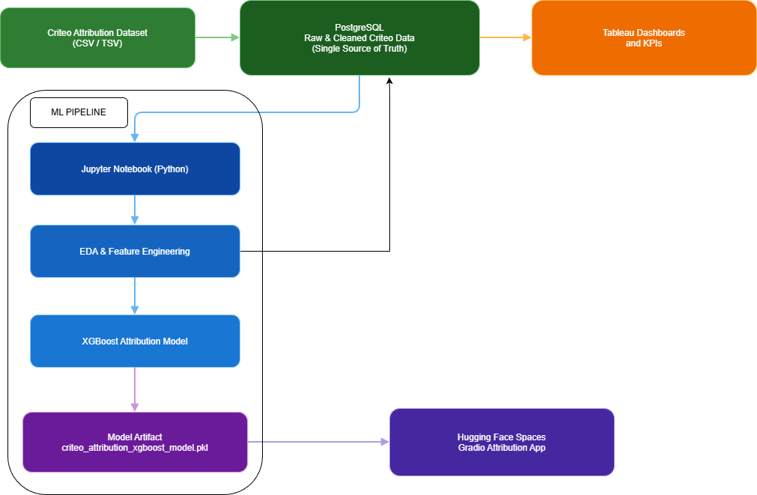
Architecture Diagram

Slide 7
Data Loading & PostgreSQL Setup
First Load — Raw Data
Second Load — Engineered Data
Source: pcb_dataset_final.csv
Target table: criteo_data (22 columns)
Chunk size: 200,000 rows | 83 batches
Source: criteo_production_ready_data.csv
Target table: criteo_data_fe (36 columns)
Chunk size: 200,000 rows | 83 batches
Why PostgreSQL?
Scales well for analytical workloads: Handles wide tables and tens of millions of records with ease.
Rich indexing & query optimization: Powerful planner for complex joins and feature heavy datasets.
Open-source & production-proven: No licensing cost, widely adopted in industry grade data pipelines.
Excellent ecosystem support: Seamless integration with Python, BI tools, and ML workflows.
High-performance bulk loading: Native copy command enables fast ingestion of millions of rows efficiently.
5

Slide 8
EXPLORATORY DATA ANALYSIS

Slide 9
Exploratory Data Analysis
Attribution Rate
Class Imbalance Problem
Data Quality Checks
2.69%
- Our target variable is highly imbalanced.
- This is common in online advertising, because conversions are rare.
- Missing values were zero.
- There were no major outliers, and data was stable over time.
Imbalance Percentage
Statistical Methods
Correlation: To check how numerical features are related to attribution
Chi-Square Test: To test for categorical features to see if they are related to attribution.
Mutual Information: To find non-linear relationships that correlation cannot find.
Mann-Whitney Test: To compare feature values between converted and non-converted users.
Combined Score: We combined all these results into one score to rank the most important feature.

Slide 10
FEATURE ENGINEERING

Slide 11
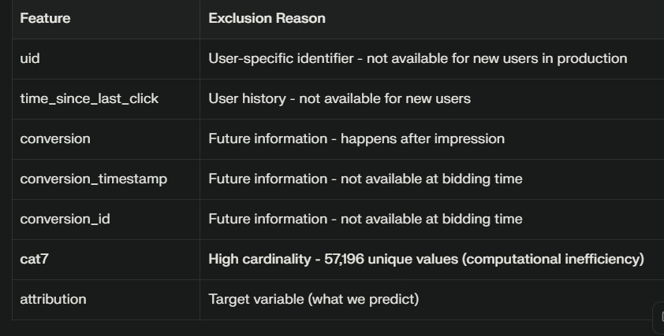
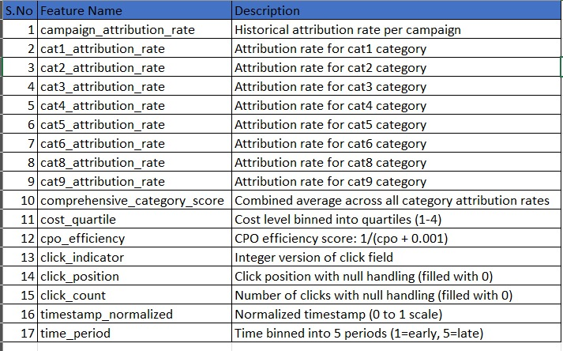
Excluded Features and Engineered Features
Original features: 15 | Engineered: 17 | Total: 32
Excluded Features
Engineered Features

Slide 12
Overview of Engineered Features
Original features: 15 | Engineered: 17 | Total: 32
All available at impression/bidding time • No user-specific history required
Campaign Performance
Contextual Categories
• campaign_attribution_rate: historical rate
• 674 reliable campaigns (≥50 impressions)
• Performance range: 0.11% to 19.02%
• cat1–cat9 attribution rates (cat7 excluded)
• comprehensive_category_score combined
• Holistic contextual targeting assessment
Cost & Click Features
Temporal Features
• cost_quartile: Low/Med-Low/Med-High/High
• cpo_efficiency: normalized ROI score
• click_indicator, click_position, click_count
• timestamp_normalized: dataset position
• time_period: categorical time bins
• Captures cyclical and trend patterns

Slide 13
MODEL SELECTION

Slide 14
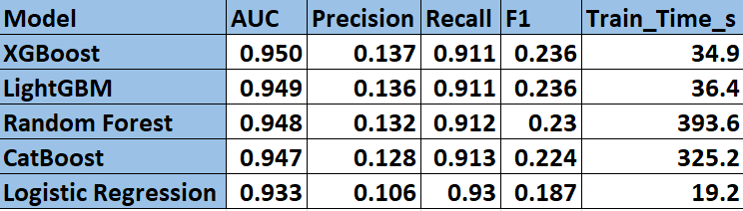
Algorithm Comparison

Slide 15
Algorithm Comparison: ROC-AUC

Slide 16
Model Performance Comparison
Best ROC-AUC
Best Precision
Fastest Training
0.951
13.9%
34.9s
Highest discrimination capability among all models tested
Minimizes wasted ad spend with best trade-off
On 16.4M rows — enables daily/weekly retraining
XGBoost Selected as Production Model
Superior performance across all key metrics with production-ready infrastructure

Slide 17
Why XGBoost ? Selected Production Model
XGBoost
ROC-AUC
Precision
Recall
Training
0.951
13.9%
91.3%
34.9s
Highest discrimination
29% vs baseline
Captures true attributions
Daily retraining feasible
Hyperparameter Configuration
• n_estimators: 100 | max_depth: 8
• learning_rate: 0.1
• scale_pos_weight: 36.06
(addresses 36:1 class imbalance)
• eval_metric: logloss | random_state: 42

Slide 18
Technology Stack
Python 3.11.9
PostgreSQL
• pandas 2.3.3
• NumPy 2.3.5
• scikit-learn
• Jupyter Notebook
• psycopg2-binary 2.9.11
• SQLAlchemy 2.0.45
• COPY bulk loading
• 16.4M rows indexed
Machine Learning
Visualization
• XGBoost (production)
• LightGBM (backup)
• Random Forest
• CatBoost, Logistic Reg.
• matplotlib
• seaborn
• Statistical visualizations
• EDA analysis

Slide 19
Business Impact & Production Readiness
29%
91.3%
34.9s
~150×
Precision
Improvement
Attribution
Capture Rate
Training
Time
Load Speed
vs INSERT
Production Readiness
Business Impact
• All features available at impression/bidding time
• No user-specific personalization required
• Fast inference (microseconds per prediction)
• Daily/weekly retraining feasible
• Handles 36:1 class imbalance effectively
• 29% reduction in false positives (wasted ad spend)
• 91.3% capture rate of true attribution events
• Revenue preservation through high recall
• Daily retraining enables market adaptation
• Production-ready for cold-start users

Slide 20
Conclusion & Future Work
Project Achievements
• Production-ready XGBoost model achieves 95.0% ROC-AUC on 16.4M impressions
• Feature engineering strictly adhered to production constraints (no future leakage)
• PostgreSQL COPY command achieved efficient loading (under 6 minutes)
• 29% precision improvement over baseline while maintaining 91.3% recall
XGBoost | ROC-AUC 0.950 | 35 Features | 16.4M Impressions | CDAC PG-DBDA | Jan 2026

Slide 21
Demo
https://huggingface.co/spaces/adi-09/criteo-attribution-app-g
XGBoost | ROC-AUC 0.950 | 35 Features | 16.4M Impressions | CDAC PG-DBDA | Jan 2026

Slide 22
Questions and Discussion
XGBoost | ROC-AUC 0.950 | 35 Features | 16.4M Impressions | CDAC PG-DBDA | Jan 2026

Slide 23
Thank you

